Slide 1


2025 6th GLOBAL CONFERENCE FOR ADVANCEMENT IN TECHNOLOGY (GCAT 2025)
DeepWaterSeg: High-Resolution Satellite Imagery Analysis for Water Body Extraction Using ResNet-U-Net
Paper ID: 2510
PRESENTER NAME: ANJANEYA KUMAR RAMISETTY
Affiliation:Narasaraopeta Engineering College (Autonomous), Narasaraopet- Affiliated by JNTUK

Slide 2
INDEX
Content | Slide number
Abstract & Objective | Slide 3
Introduction | Slide 4
Problem Statement & Motivation | Slide 5
Literature Review | slide 6
Dataset & Preprocessing | Slide 7
Proposed Methodology | Slide 8
Training Configuration | Slide 9
Results & Evaluation | Slide 10
Comparison with Other Works | Slide 11
Applications ,Impact & Conclusion | Slides 12 & 13

Slide 3
Abstract & Objective
The proposed research, DeepWaterSeg, introduces a deep learning model for accurate water body segmentation using high-resolution satellite imagery. It integrates a ResNet50-based U-Net architecture to detect and map diverse water bodies such as rivers, ponds, and lakes across complex terrains. Traditional methods are slow and less precise, whereas this model achieves 96% pixel-wise precision and 92% accuracy, effectively identifying even thin or narrow water structures. The system’s robustness enables large-scale, near–real-time water mapping, which is crucial for disaster management, resource allocation, and aquatic ecosystem conservation. The objective is to develop a reliable, automated segmentation framework that supports sustainable water management and enhances ecological monitoring through deep learning and remote sensing technologies.

Slide 4
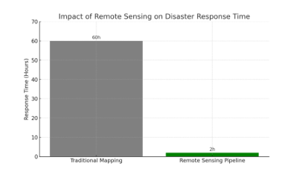
Introduction
Water bodies such as lakes, rivers, and ponds play a vital role in maintaining ecological balance, supporting biodiversity, and providing essential resources for agriculture, industry, and domestic use. Accurate identification and monitoring of these water bodies are crucial for effective disaster management, climate regulation, and sustainable water resource planning. Traditional methods of water body detection are often slow and inefficient, especially during natural disasters like floods. Recent advancements in remote sensing and deep learning have made it possible to automate this process with greater accuracy and speed. However, challenges such as varying water color, seasonal changes, and complex terrain still affect detection accuracy. To address these challenges, this research proposes a ResNet50-based U-Net architecture capable of delivering precise, real-time water body segmentation from high-resolution satellite imagery.

Slide 5
Problem statement and motivation
Detecting water bodies from satellite images is difficult due to variations in color, terrain, and seasonal changes.
Traditional methods struggle to accurately capture narrow and complex boundaries.
DeepWaterSeg, integrating ResNet50 and U-Net, provides precise and automated detection to support disaster management and ecosystem monitoring.

Slide 6
Literature Review
Recent models like DMLU-Net, SDNet, and AER U-Net enhanced segmentation using dual encoders and attention mechanisms.
These models often face challenges such as high computational cost and poor generalization.
DeepWaterSeg uses a ResNet50 backbone with U-Net decoding, utilizing pretrained features for accuracy and efficiency.
It achieves higher precision, lower complexity, and faster convergence across diverse, high-resolution datasets.

Slide 7
Dataset Preprocessing
The dataset, obtained from Kaggle, comprises 2,481 high-resolution satellite images paired with ground-truth masks. It captures a wide range of terrains and waterbody types, including blue freshwater, green algae, and murky leachate, allowing the model to adapt across varied environmental conditions. The diverse visual characteristics ensure robust feature learning and better generalization. This rich dataset serves as a comprehensive foundation for training DeepWaterSeg to perform accurately across mixed geographic and climatic landscapes.
The preprocessing pipeline includes RGB conversion, grayscale mask generation, and resizing all images to 256×256 pixels. Pixel values are normalized to a 0–1 range, and mask dimensions are expanded for compatibility with the ResNet50 backbone. Additional enhancement steps remove shadows, reduce color distortion, and sharpen water boundaries. These preprocessing measures ensure uniform input quality, align with ResNet50’s input expectations, and significantly enhance segmentation accuracy across varied water types and terrain complexities.

Slide 8
Proposed Methodology
DeepWaterSeg employs a hybrid ResNet50-U-Net model for semantic segmentation. ResNet50 functions as the encoder, capturing hierarchical spatial-semantic features, while the U-Net decoder reconstructs detailed segmentation maps through upsampling and skip connections. The model effectively maps complex image features into binary water masks, enabling precise detection of narrow rivers and ponds. Training involves 30 epochs on normalized 256×256 inputs using binary cross-entropy and Dice losses. This architecture balances high accuracy with reduced computational cost and strong generalization.

Slide 9
Training Configuration
Parameter | Configuration / Description
Input Size | 256 × 256 × 3 (RGB images)
Batch Size | 8
Epochs | 30
Optimizer | Adam
Learning Rate | 0.0001
Loss Function | Binary Cross-Entropy + Dice Loss
Activation Functions | ReLU (hidden layers), Sigmoid (output layer)
Validation Split | 0.2 (20% for validation)
Regularization | Applied to prevent overfitting
Normalization | Ensured consistent feature scaling

Slide 10
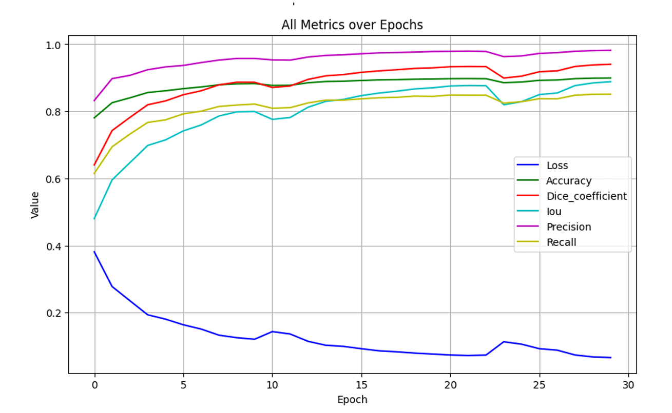
Results and Evolution
Metric | Result
Precision | 96%
Accuracy | 92%
Dice Coefficient | 91%
Intersection over Union (IoU) | 90%
Loss | 6%

Slide 11
Comparison with Other Works
DeepWaterSeg outperforms or matches models like DMLU-Net, SDNet, and AER U-Net while maintaining lower computational complexity.
Unlike prior models that rely on heavy architectures or terrain-specific datasets, it generalizes effectively across diverse satellite imagery.
Achieves 96% precision, surpassing the ~91% average of previous approaches, without using attention mechanisms.
Demonstrates strong adaptability to rivers, ponds, and lakes in both rural and urban areas, proving its real-world applicability for remote sensing.

Slide 12
Applications, Impact & Conclusion
DeepWaterSeg advances automated water-body mapping using high-resolution imagery and deep learning. It supports faster flood response, efficient freshwater management, and sustainable resource planning. The model’s scalability aids national water monitoring systems and environmental conservation. By integrating AI into remote sensing, it contributes to UN Sustainable Development Goals, promoting ecological accountability and informed decision-making. In conclusion, the ResNet50-U-Net model provides an accurate, efficient, and impactful tool for global water-body detection and environmental sustainability.

Slide 13


